Slide 1
冒險故事
(Animaze)
Notes:
大家好，接下來我要分享我的冒險故事

Slide 2

Notes:
A young man with short silver-white hair, slightly messy but layered, with bangs slightly covering the forehead, golden-orange eyes, with a soft and calm gaze, and gentle eye contours, wearing a black top with gold accents around the collar, and a coat that appears to have a white fur collar, with multiple earrings on both ears, with visible piercings, preparing for his journey to the snowy mountains, gathering information, studying maps, and collecting gear in Japanese anime style
我從小熱愛繪畫，一直夢想有一天能走遍世界，創作出驚艷世人的作品。某天，我偶然得知一個傳說：在遙遠的雪山深處藏著一幅神秘的古畫，據說只要找到它，便能獲得無窮的創作靈感

Slide 3
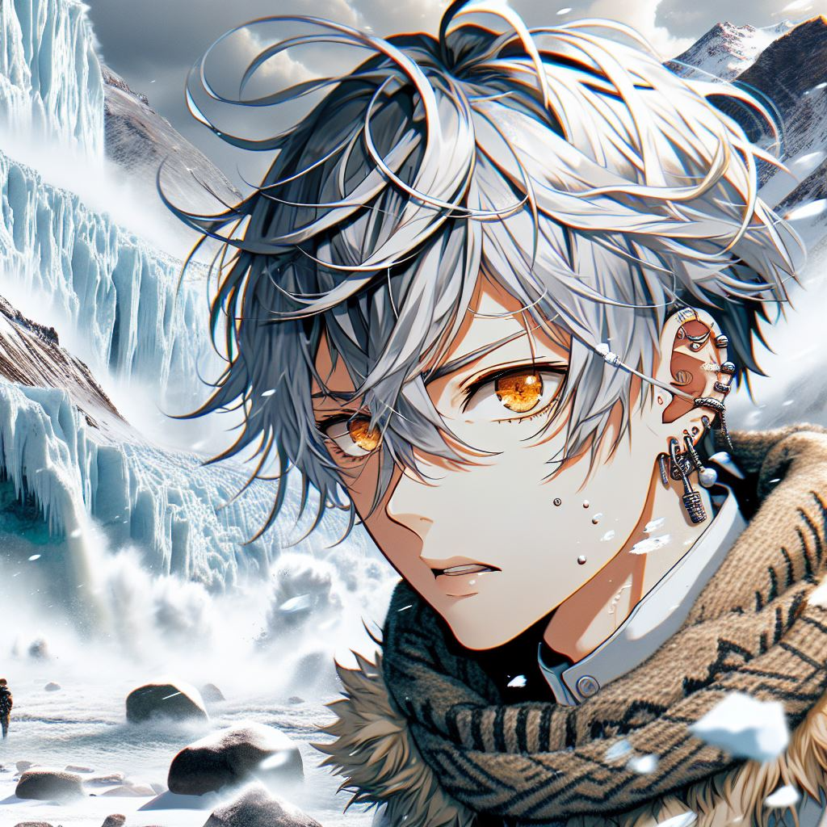
Notes:
A young man with short silver-white hair, slightly messy but layered, with golden-orange eyes, with multiple earrings on both ears, with visible piercings, suffering when encountered natural disasters such as glacier avalanches and avalanches, as well as the constant onslaught of cold in Japanese anime style
我心中燃起了強烈的渴望，決定踏上尋找這幅傳奇古畫的旅程。然而，雪山的險峻超乎我的想像。途中遇上了冰川崩裂、雪崩等天災，還有不斷侵襲的嚴寒

Slide 4
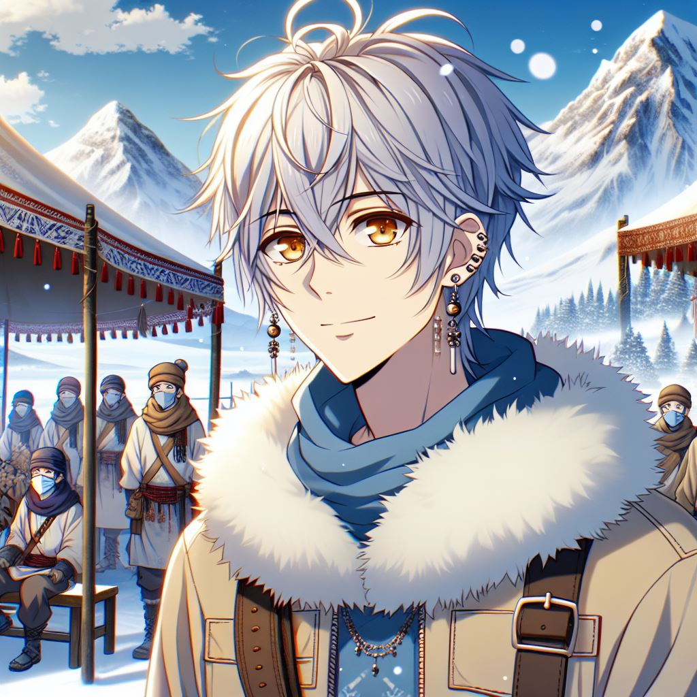
Notes:
A young man with short silver-white hair, slightly messy but layered, with golden-orange eyes, with multiple earrings on both ears, with visible piercings, making friends with nomadic tribes in the snowy mountains in Japanese anime style
儘管如此，我沒有放棄，我學會如何在惡劣環境中生存，與山中的遊牧部落交朋友，並向他們學習如何辨別方向與尋找藏匿的古蹟

Slide 5
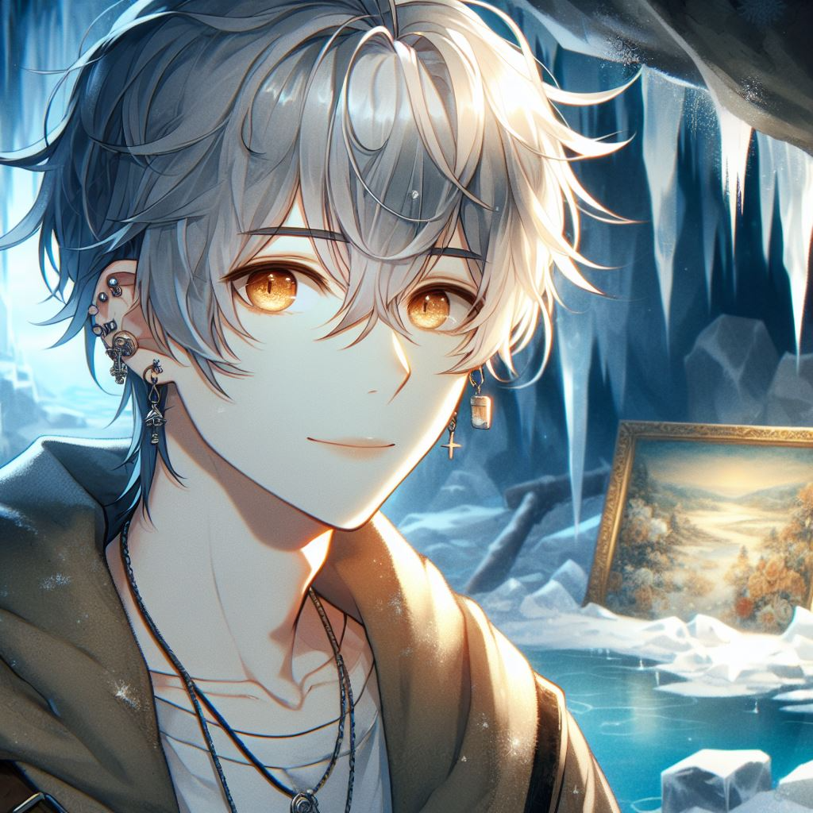
Notes:
A young man with short silver-white hair, slightly messy but layered, with golden-orange eyes, with multiple earrings on both ears, with visible piercings, finding the legendary hiding place of the ancient painting in the frozen caves and discovering the mysterious painting with a soft and calm gaze, and gentle eye contours in Japanese anime style
經過數月的艱苦跋涉，我終於來到傳說中的古畫藏身之地。在冰封的洞穴中，我找到了那幅神秘的畫作

Slide 6
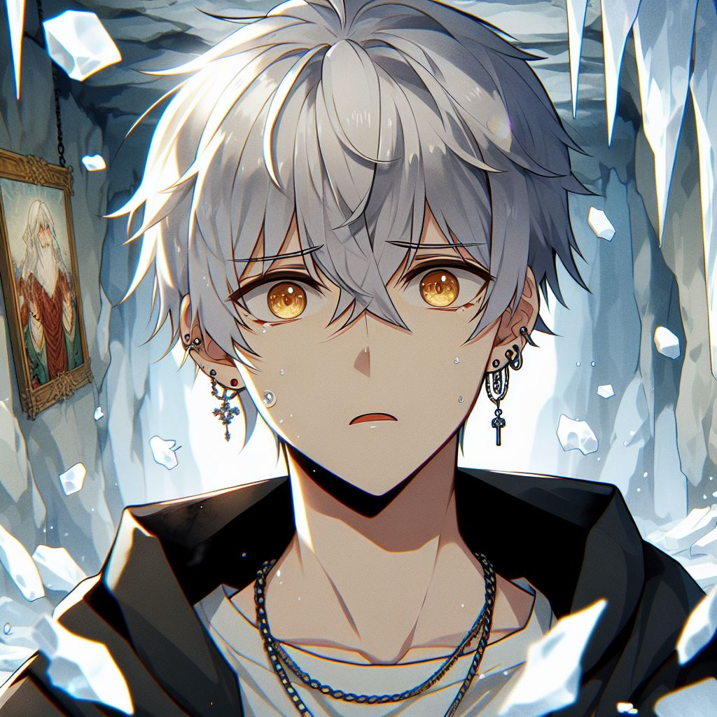
Notes:
然而，就在我伸手取畫時，洞穴內的冰牆突然塌陷，將古畫摧毀，碎片散落一地

Slide 7
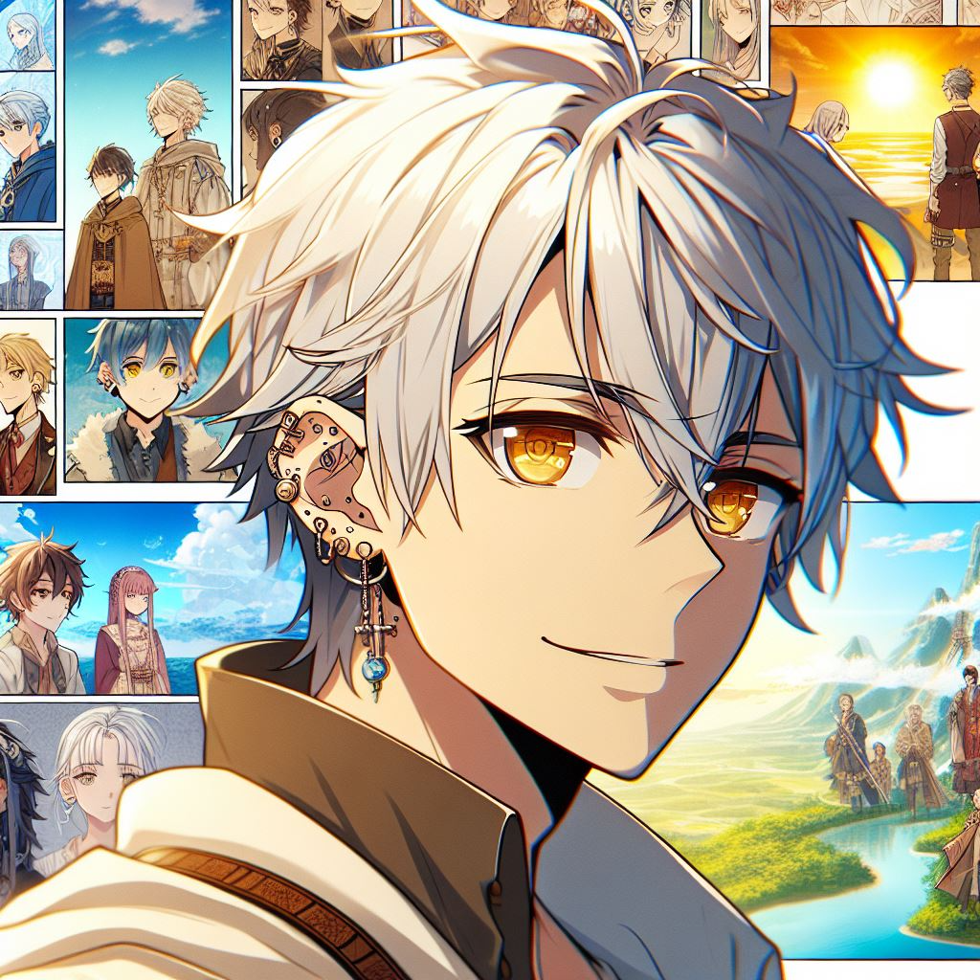
Notes:
A young man with short silver-white hair, slightly messy but layered, with golden-orange eyes, with multiple earrings on both ears, with visible piercings, showing an expression of realization and inspiration as he reflects on the process of adventure and the scenery and people he saw and met on his journey in Japanese anime style
面對這突如其來的災難，我心中充滿了挫敗與失落。並想著，自己辛苦了這麼久，難道一切都白費了嗎？但經過深思熟慮，我意識到，冒險的過程和旅途中看到的風景、遇見的人們，已經成為我無窮的創作靈感來源

Slide 8
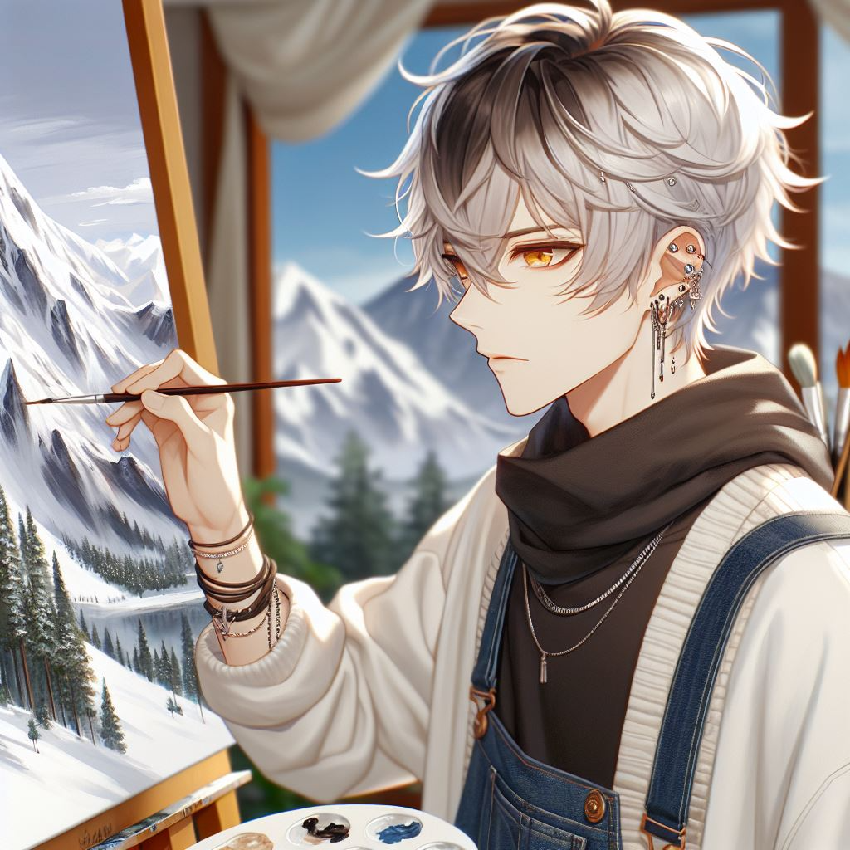
Notes:
A young man with short silver-white hair, slightly messy but layered, with golden-orange eyes, with multiple earrings on both ears, with visible piercings, painting a snow-capped mountain in Japanese anime style
我不再執著於那幅古畫，而是將旅途中所見所感融入自己的畫作中。回到家鄉後，我創作了一系列以雪山與人為題材的作品，這些畫作充滿了生命力與深度，讓我的名字迅速傳遍藝術界。這場冒險雖然未能帶回傳說中的古畫，但卻讓我找到了自己真正的藝術方向

